Slide 1
Notes:
Note: Please go into presentation mode first and advance to the next slide by clicking with the mouse. This ensures that the Four Perfect Pebbles song will automatically play alongside the slides.
PowerPoint presentation created by Erin Menconi, LMS of Timber Ridge Middle School, Plainfield, Illinois.

Slide 2
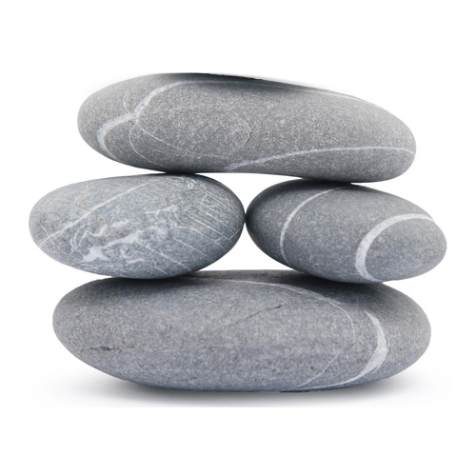
Four Perfect Pebbles
Notes:
Note: Please go into presentation mode first and advance to the next slide by clicking with the mouse. This ensures that the Four Perfect Pebbles song will automatically play alongside the slides.

Slide 3
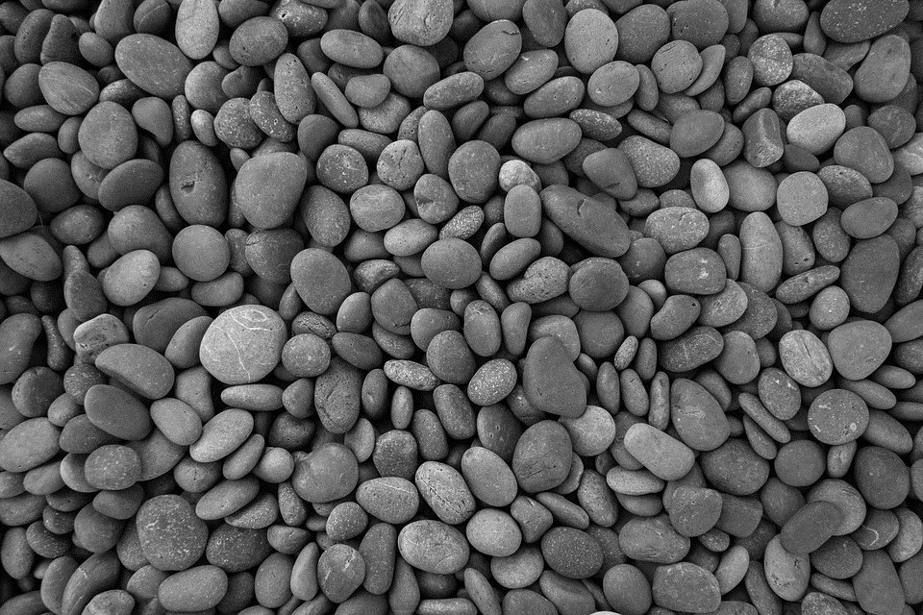
Four Perfect Pebbles in my hand Some made of granite, some of sand. Found in this dark and desolate land Four Perfect Pebbles in my hand.
Notes:
Note: Please go into presentation mode first and advance to the next slide by clicking with the mouse. This ensures that the Four Perfect Pebbles song will automatically play alongside the slides.

Slide 4
Mother comforts Albert and me Father shields us from misery. No parent’s love can ever erase This sad and forgotten, lonely place.
Notes:
Note: Please go into presentation mode first and advance to the next slide by clicking with the mouse. This ensures that the Four Perfect Pebbles song will automatically play alongside the slides.

Slide 5
Four Perfect Pebbles do I see One for each member of my family. I’ll hold them tight, I will not cry All will live, no one will die.
Notes:
Note: Please go into presentation mode first and advance to the next slide by clicking with the mouse. This ensures that the Four Perfect Pebbles song will automatically play alongside the slides.

Slide 6
If I should lose my precious stones My secret hiding place will reveal More perfect pebbles far beneath These barracks made of wood and steel.
Notes:
Note: Please go into presentation mode first and advance to the next slide by clicking with the mouse. This ensures that the Four Perfect Pebbles song will automatically play alongside the slides. PowerPoint presentation created by Erin Manconi, LMS of Indian Trail Middle School, Plainfield, Illinois

Slide 7
Four Perfect Pebbles do I see Mother, Father, Albert and me. I count them over one by one I fall fast asleep, my work… is… done.
Notes:
Note: Please go into presentation mode first and advance to the next slide by clicking with the mouse. This ensures that the Four Perfect Pebbles song will automatically play alongside the slides.

Slide 8
Notes:
Note: Please go into presentation mode first and advance to the next slide by clicking with the mouse. This ensures that the Four Perfect Pebbles song will automatically play alongside the slides.

